Slide 1

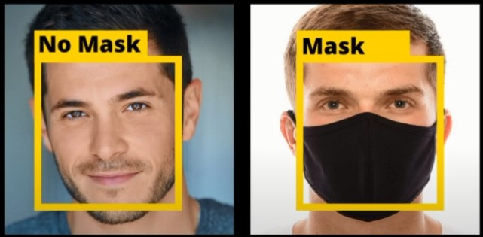
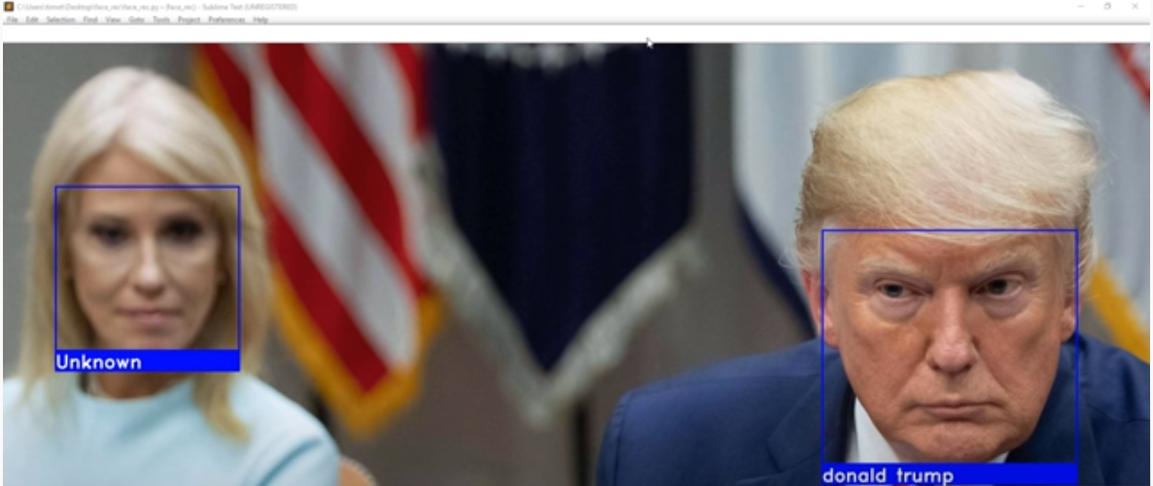
THIAGARAJAR COLLEGE OF ENGINEERING, MADURAI – 625 015 (A Govt. Aided Autonomous Institution Affiliated to Anna University) 18ES390 – DESIGN THINKING – POSTER PRESENTATION DEPARTMENT OF COMPUTER SCIENCE ENGINEERING
Team Name: TEEN TITANS
Team Members: Arvin Danny C S (19C008); Dhanushwaran P S (19C016); Nandhakumar Raj S (19C057); Nishok Anand B (19C061)
Faculty Mentor : Mrs. Raja Lavanya
The coronavirus COVID-19 pandemic is the defining global health crisis of our time.
It spreads primarily when people are in close contact and one person inhales small droplets produced by an infected person.
The cheapest and one of the most effective method of prevention is to wear a mask.
And the biggest problem we face is when people do not abide by these simple measures.
SPECIFICATION DEVELOPMENT
PROBLEM IDENTIFICATION
Problem Environment: Workspace, educational institutes, and public places.
Goals and function: Automated Crowd Mask detector to alert defaulters.
Constraints: For good performance we need effective hardware.
Description of measurable specifications: High performance computer, high quality camera.
CONCEPTUAL DESIGN

